Slide 1
lower duress at scale for America’s 80% to qualitatively increase decision making
Bills = Duress = Poor Choices = Societal Degradation
generate sustainable high profit while each
micro payment solves human created issues
exit $500MM+ 10M User @$10.44/Y x 5Y = $522MM valuation Bank / Social Payment Competitor

Slide 2
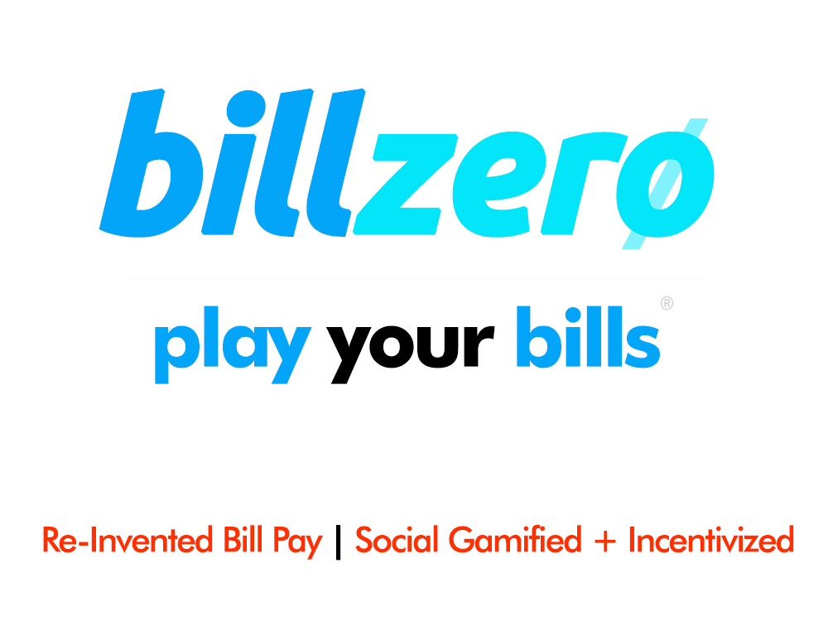
Nathan Briggs, CxO 602.795.2289
ctoxyz@gmail.com

Slide 3
Problem
100 Million Can’t Pay Bills + Use P2P
P2P Fraud Up 733%
No Social Bill Pay Platform exists

Slide 4
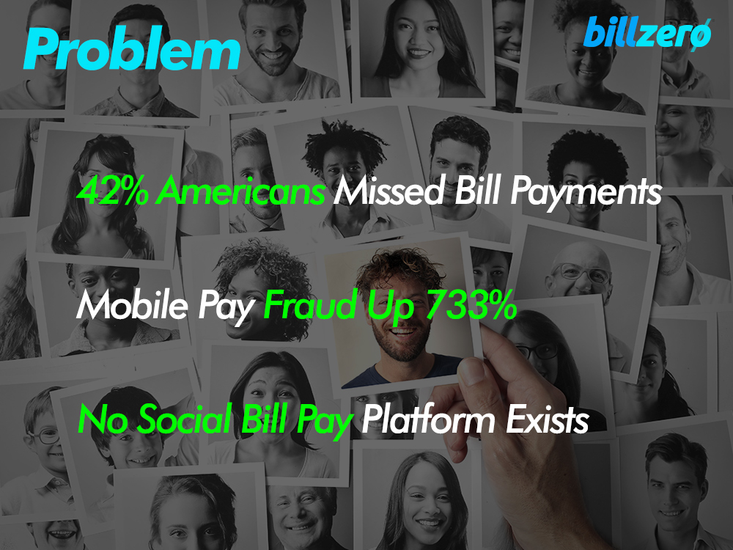
Problem
100 Million Can’t Pay Bills + Use P2P
P2P Fraud Up 733%
No Social Bill Pay Platform exists

Slide 5
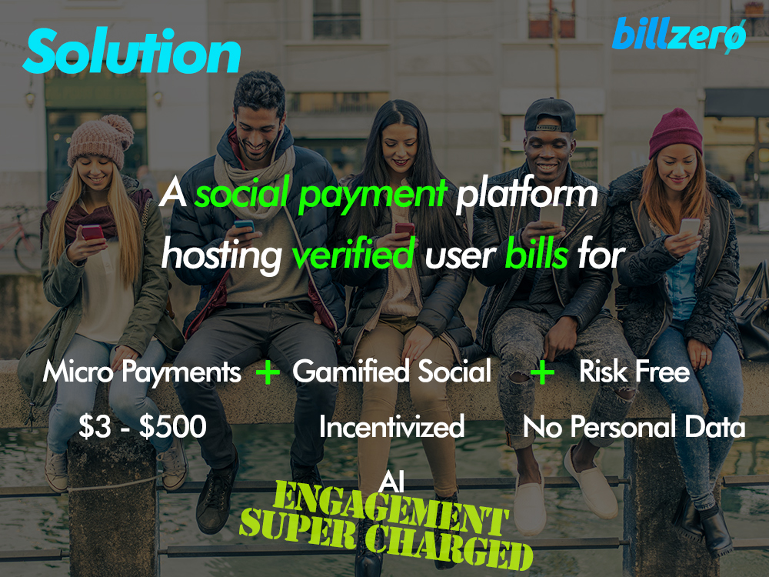
Solution
An AI incentivized & gamified risk-free social payment platform hosting verified user bills for
Micro Payments
$3 to $500
Gamified Social Propagation
Incentivized Engagement
AI Powered
Risk Free Money Transfer
No Personal Data Bankless Access

Slide 6
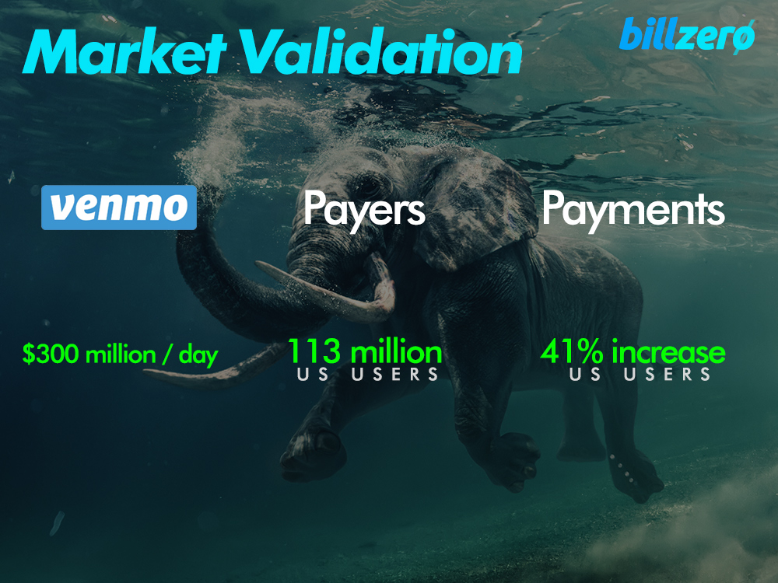
Market Validation
Venmo Processes
$300 Million
a Day
P2P Use 113 Million
US People
Mobile Pay
41% Increase
US Mobile Payment Market
2019
$69Bn - $98Bn

Slide 7
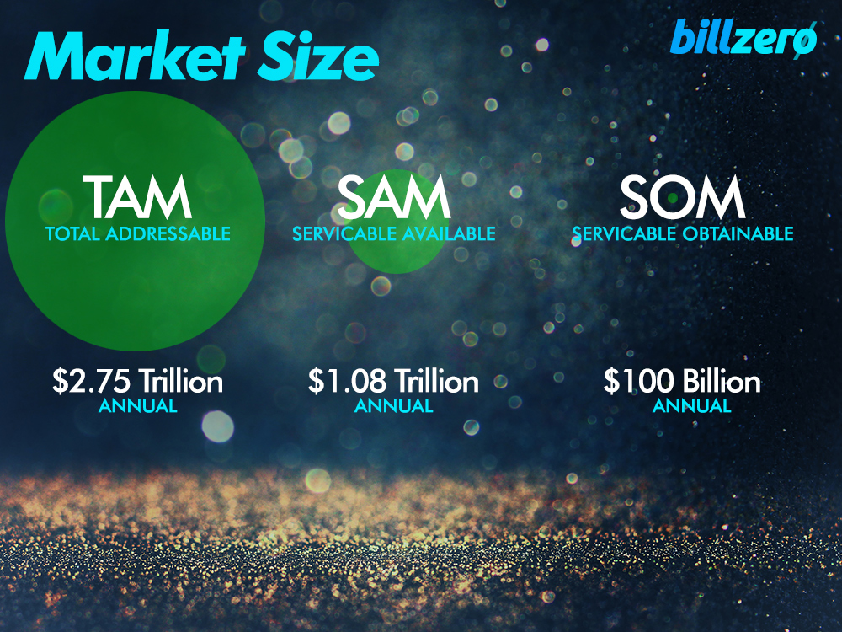
Market Size
TAM $2.75 Trillion
Annual
SAM $1.08 Trillion Annual
Auto, Util, Edu, Med, Home 39%
GOAL $100 Billion Annual
10% of Market

Slide 8
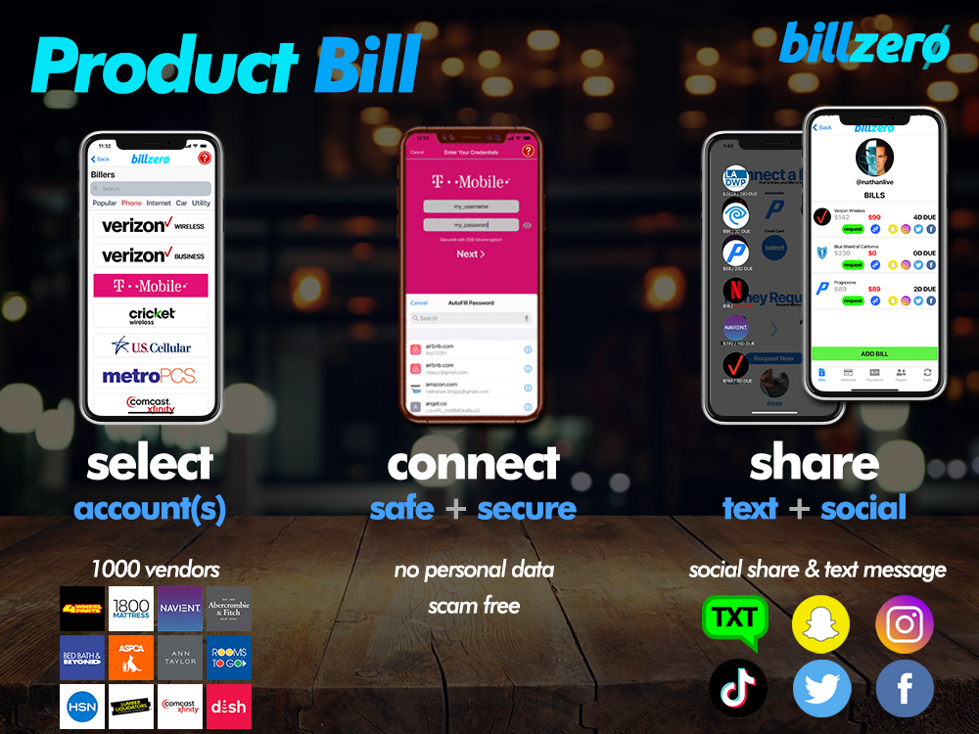
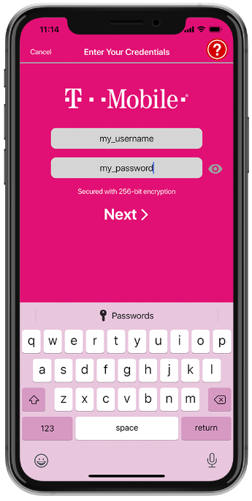
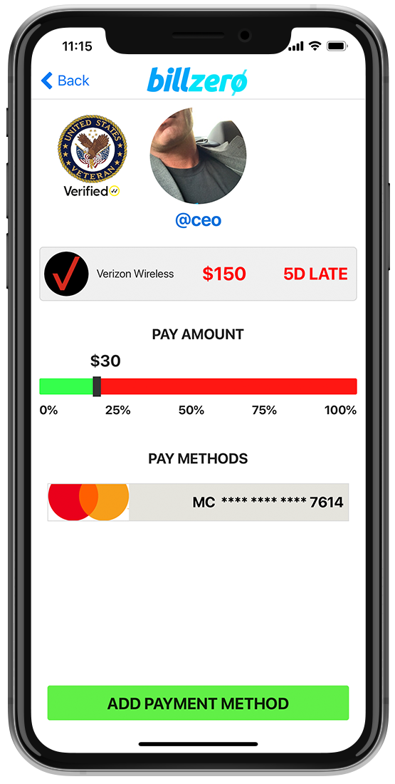
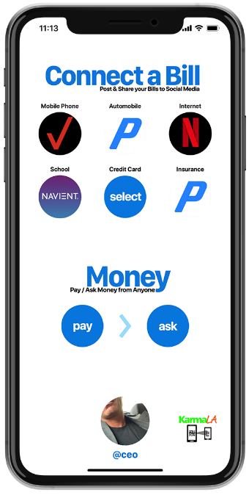
Product | Share = Payments
Share Bill
Text a Money Request
Social Network Sharable
All Bills = 100% Authentic
Pay Bills
Select Bill, Amount & Pay
Real-Time Payment & ACH

Slide 9
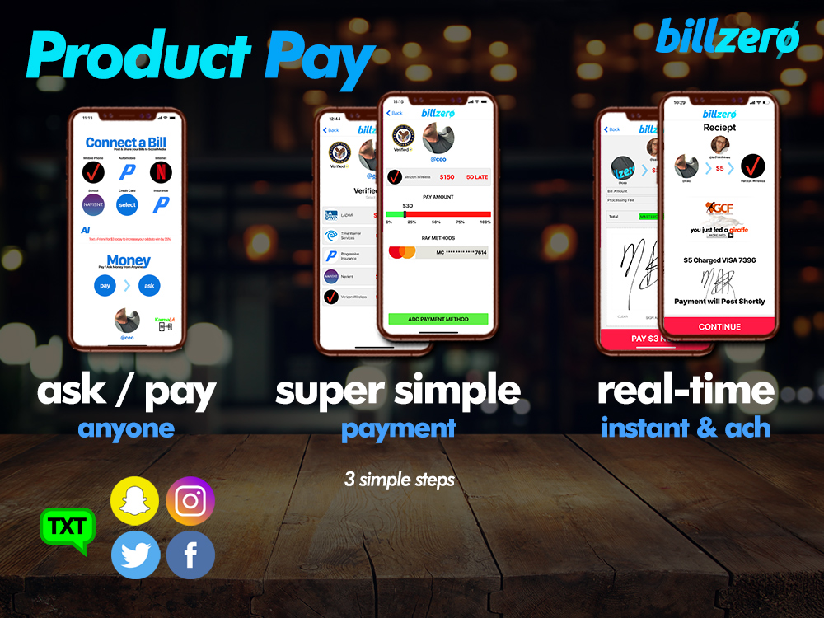
Product | Share = Payments
Share Bill
Text a Money Request
Social Network Sharable
All Bills = 100% Authentic
Pay Bills
Select Bill, Amount & Pay
Real-Time Payment & ACH

Slide 10
Business Model
Profit Margin
21%
to
53%
Payments
$3 Micro
to
$500
Gamified
Daily Incentivized
Social Propagation & Engagement

Slide 11
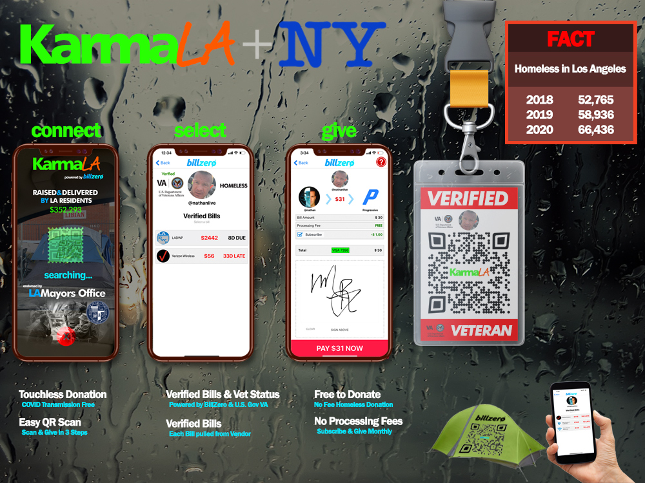

Slide 12
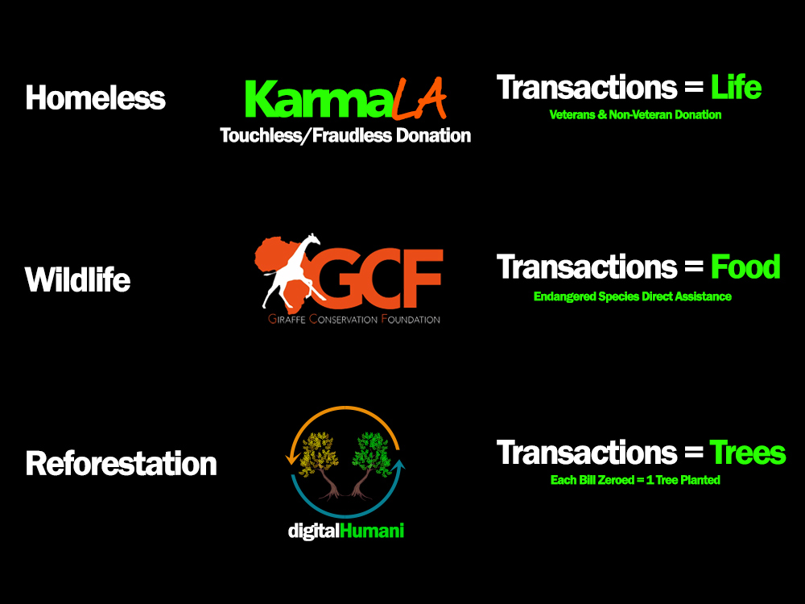

Slide 13
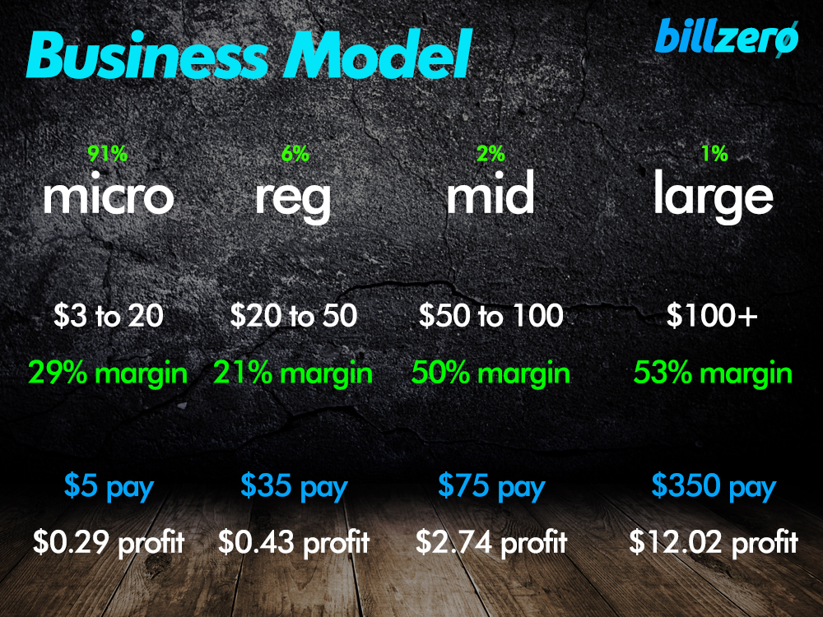
Business Model
Profit Margin
21%
to
53%
Payments
$3 Micro
to
$500
Gamified
Daily Incentivized
Social Propagation & Engagement

Slide 14
Financial Forecast
1K Users
3 Bills per User
3 Pays per Bill
$50K
Gross Profit / Year
250K Users
3 Bills per User
3 Pays per Bill
$12.5M
Gross Profit / Year
5M Users
3 Bills per User
3 Pays per Bill
$250M
Gross Profit / Year

Slide 15
Market Adoption
Unlimited Sign-Up Incentive
Free Daily Bill Money Drawing
Maximizing Engagement
PARTNER Veterans Affairs Department
18 Million Vets
Virality
Gamified Incentivized Recursive Propagation

Slide 17
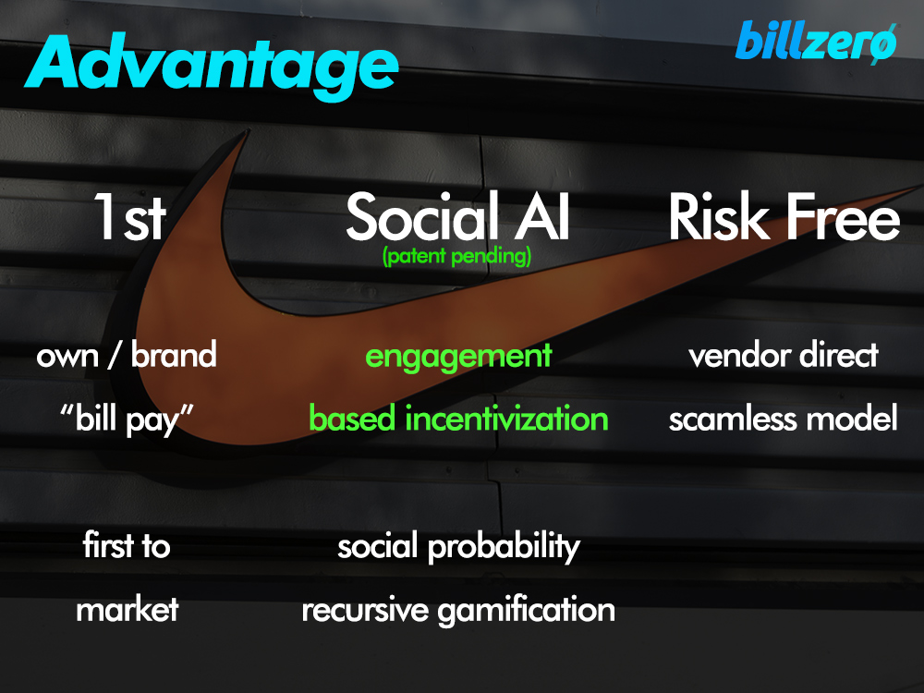
Competitive Advantage
First To Market
We will own social Bill Payment
Bills = Money
Algorithm Based Engagement
AI Patents Pending
Fraudless
Direct Social Bill Pay

Slide 18
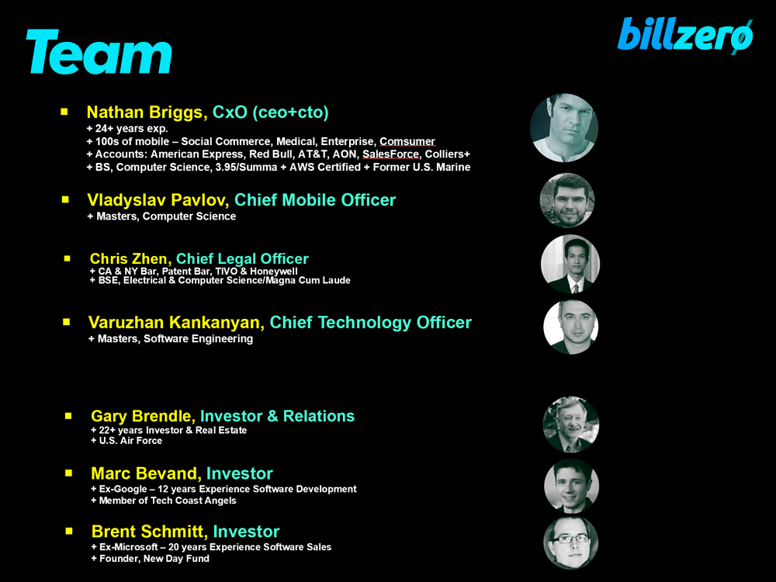
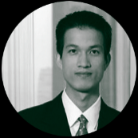
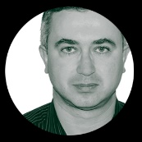
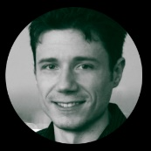
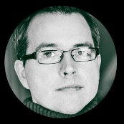
Team
Nathan Briggs, CxO (ceo+cto) + 27+ years exp. + 100s of mobile – Social Commerce, Medical, Enterprise, Comsumer + Accounts: American Express, Red Bull, AT&T, AON, SalesForce, Colliers+ + BS, Computer Science, 3.95/Summa + AWS Certified + Former U.S. Marine
Chris Zhen, Chief Legal Officer + CA & NY Bar, Patent Bar, TIVO & Honewell + BSE, Electrical & Computer Science/Magna Cum Laude
Varuzhan Kankanyan, Chief Technology Officer + Masters, Software Engineering
Gary Brendle, Investor & Relations + 22+ years Investor & Real Estate + U.S. Air Force
Marc Bevand, Investor + Ex-Google – 12 years Experience Software Development + Member of Tech Coast Angels
Brent Schmitt, Investor + Ex-Microsoft – 20 years Experience Software Sales + Founder, New Day Fund

Slide 19
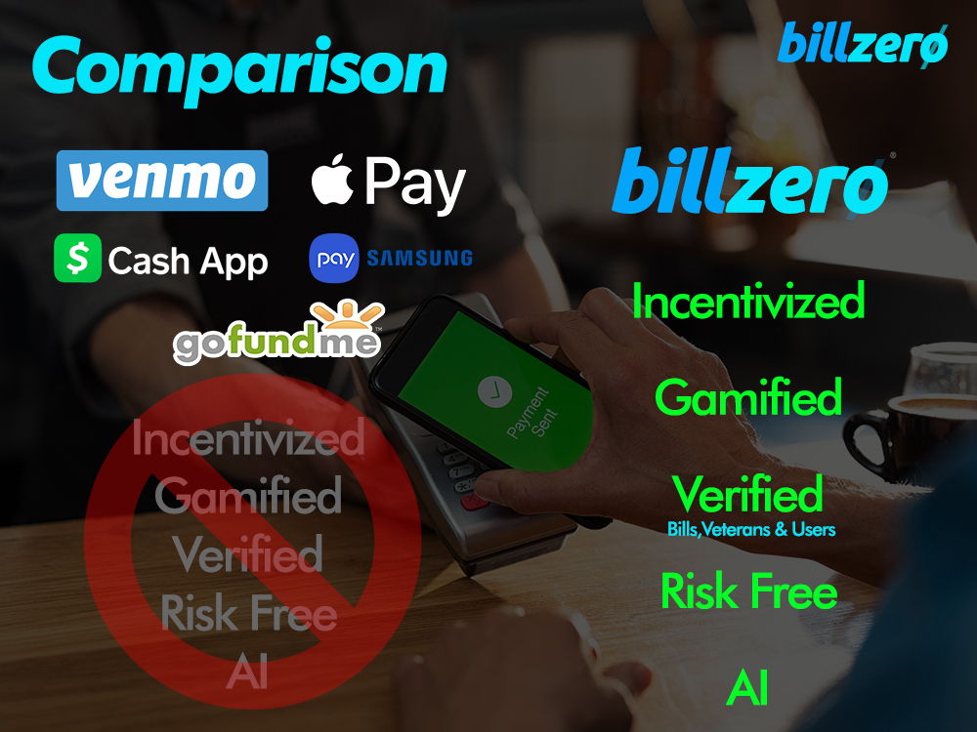
Competitive Comparison
NOT Incentivized
BillZero
NOT Fraud Free
NOT Verified
Incentivized
Verified
Venmo CashApp
Risk Free
GoFundMe
Banks

Slide 20
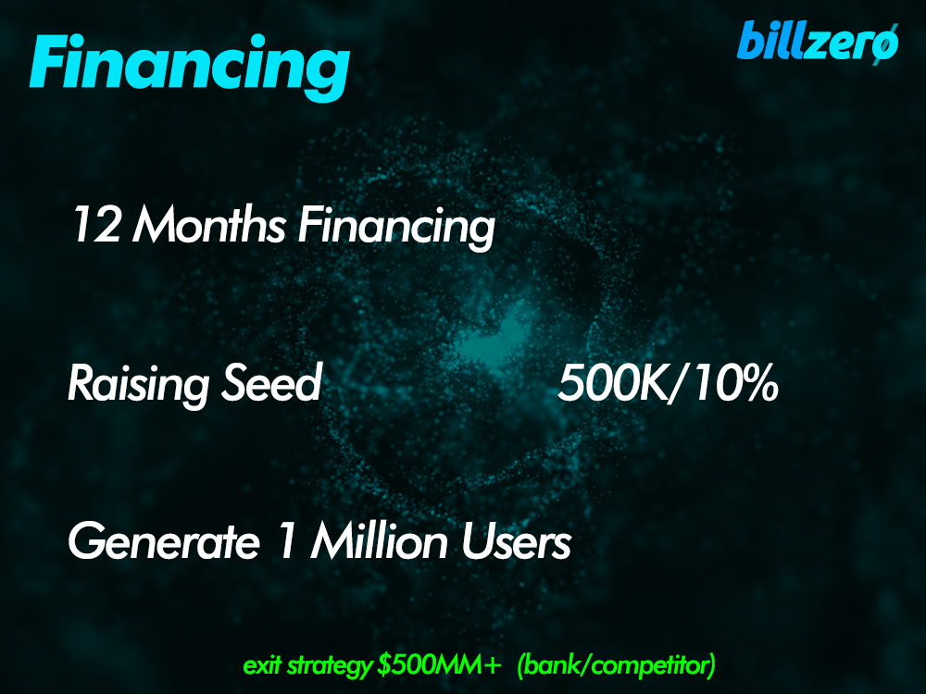
Financial
12 Months Financing
Seeking Seed 500K
Generate 1 Million Users =
Exit $500MM+ (Bank/Competitor)

Slide 21
Financial
12 Months Financing
Seeking Seed 500K
Generate 1 Million Users =
Exit $500MM+ (Bank/Competitor)

Slide 22
Questions?
Let’s Talk!
Nathan Briggs, CxO ctoxyz@gmail.com / 602.795.2289

Slide 23
Market Penetration
Deal External 30M Followers
150K - 500K
SI
Deal Internal 10M Followers
150K - 500K
All Majors CNN, CNBC, ABC, FOX...
50K - 100K
PR
Niche AARP, Military, Parents
50K - 100K
PSA
LA / NY Mayor Endorse + Vets + Homeless
500 - 1K
VA US Vets 18.8Million
20K - 50K
CPC
A/B IG FB GOOG TIK DAILYMAIL
5K - 50K
AIMED AT
YIELD 430K – 1.3M
20-50 MILLION PEOPLE
FEAR + NO SUPPORT + CAPTIVE

